Slide 1


Hotel Management System
CRN -21219
GROUP PROJECT
Sri Siva Jagadish Raj Musireddi(700756416)(Tech Leader)
Kavya Daggubati(700761986)(Database developer)
Tejaswini Kaki(700757717)(Backend developer)
Monisha Arikala(700762574)(Frontend developer)

Slide 2
My role as a Technical lead
Handled the project using different technologies by collaborating with the team members and identifying the potential in them .
Used the best optimized way and minimal complexity to design
As the Technical Lead for the project, I leveraged various technologies while collaborating closely with team members, tapping into their unique skill sets, and identifying their potential to contribute effectively to the project's success. By fostering a culture of collaboration and innovation, I ensured that each team member had the opportunity to shine and contribute meaningfully to our collective goals.

Slide 3

Project Description
The proposed database application for the hotel management system aims to streamline and enhance various aspects of hotel operations and guest experience. This comprehensive database serves as the central repository of all hotel-related data, facilitating efficient management of reservations, guest information, room availability, staff assignments, billing, and other critical functions. The purpose of the database is to enable seamless communication and coordination across different departments, ensuring timely and accurate service delivery to guests, optimizing resource allocation, and maintaining a high level of guest satisfaction.
The main users of the system include hotel staff members such as front desk personnel, and management. These users require access to different sets of data, including guest information, room statuses, reservation details, and financial transactions. By having an integrated database, staff members can efficiently manage reservations, track room availability, assign tasks, handle check-ins and check-outs, get payment from guests with their credit cards at the time of check-ins, and charge the customers on check-outs if they have damaged something in the room. This system is also used by guests to make reservations and update the reservation from the website. So, it's not necessary tocall the staff of the hotel to update or create the reservation.
In summary, the hotel management system's database application is designed to fulfill the crucial role of organizing, storing, and managing hotel-related data to improve guest experiences, operational efficiency, and overall service quality. By addressing the needs of different users and providing solutions to common challenges, the system contributes to the successful functioning of

Slide 4
The system aims to address several challenges commonly encountered in hotel management, including overbooking, room assignment errors, and delayed guest services. It seeks to solve these problems by providing real-time visibility into room availability, automating check-in and check-out processes, and facilitating smooth communication between the front office, and guests.
The database takes input data from various sources, including online reservation platforms, manual booking entries, guest details, room availability updates, and transaction records. It stores a wide range of information such as guest names, contact information, reservation dates, room types, room statuses, billing records, payment methods, and special requests. By centralizing this information, the database ensures data accuracy, reduces redundancy, and enables the hotel to provide personalized services tailored to guest preferences.
In summary, the hotel management system's database application is designed to fulfill the crucial role of organizing, storing, and managing hotel-related data to improve guest experiences, operational efficiency, and overall service quality. By addressing the needs of different users and providing solutions to common challenges, the system contributes to the successful functioning of the hotel and the satisfaction of both guests and staff.

Slide 5
Database Description
Database Description for Hotel Management We describe the anticipated behavior and interactions of the system with users and data within the context of a hotel booking project. To make reservations for rooms, guests can first register or log in to our system or else can go in person or call the hotel for the reservation. If a guest registers to the online portal each guest is given a unique identification number. The system's database securely stores the guest's information, which includes first and last names, addresses, email addresses, and phone numbers.
We keep data on important details about room availability to make the booking process easier for guests and staff. This data consists of the total number of rooms that are available, the types of rooms, the dates for which rooms are available, the maximum capacity of rooms, and brief descriptions of each room. A distinct room ID is used to identify each room.
The system records the user's arrival and departure dates after they've chosen a suitable accommodation, and then guides them through the payment process. We carefully document payment information, such as the date and time of the payment, its status, and the reservation ID that corresponds with it. This information will be used as a checkpoint for accuracy when the user checks in at the hotel. The extra charges like incidentals, pet charges, etc. needed to be charged to guests has been made easier to keep track of for both staff and guests. In Case of refunds during the checkout or any given time we have different collections so that we can keep track of all the refunds that are to be returned to the guest and by which staff member.

Slide 6
Technologies Used
MONGODB
Python
HTML
CSS
JAVASCRIPT

Slide 7
Roles
Admin
Staff
Customer

Slide 8
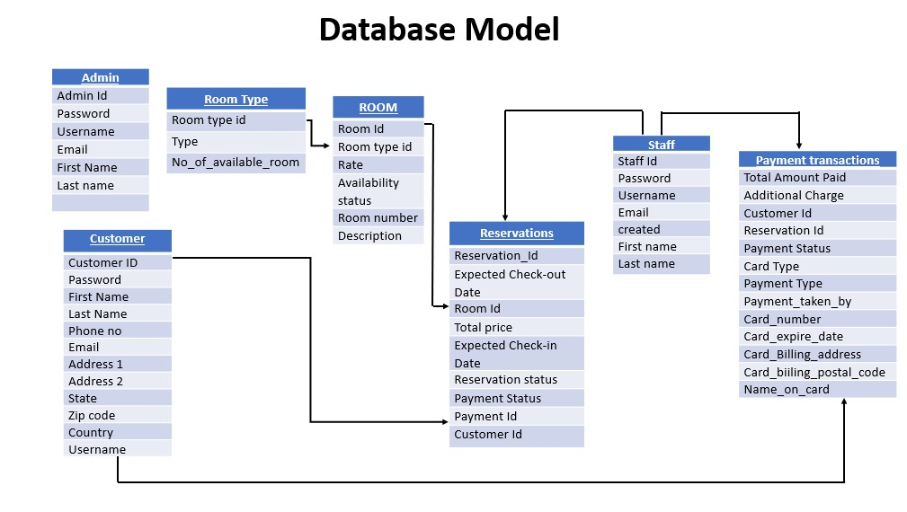

Slide 9
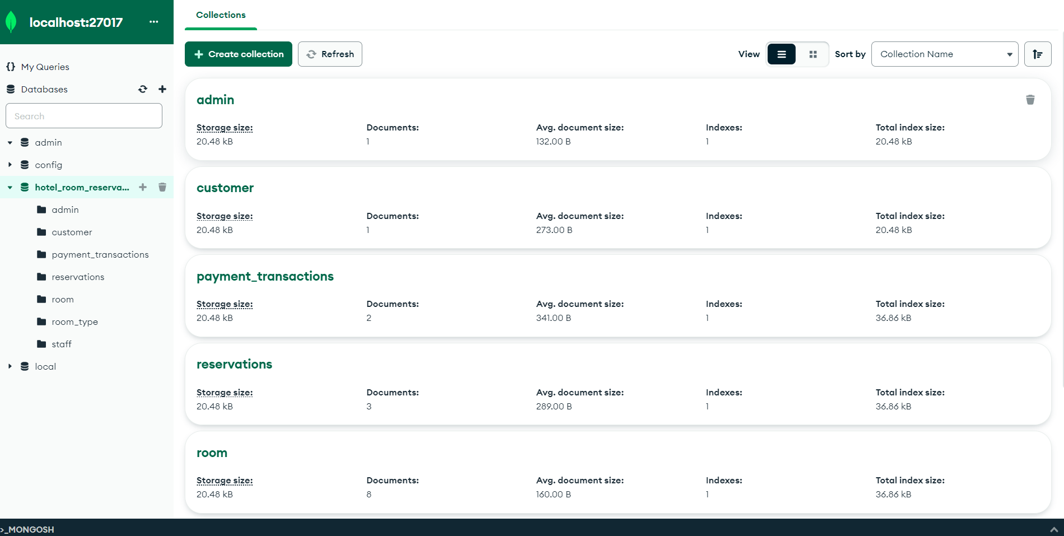
Data Dictionary & Sample Data
Data Dictionary & Sample Data

Slide 10
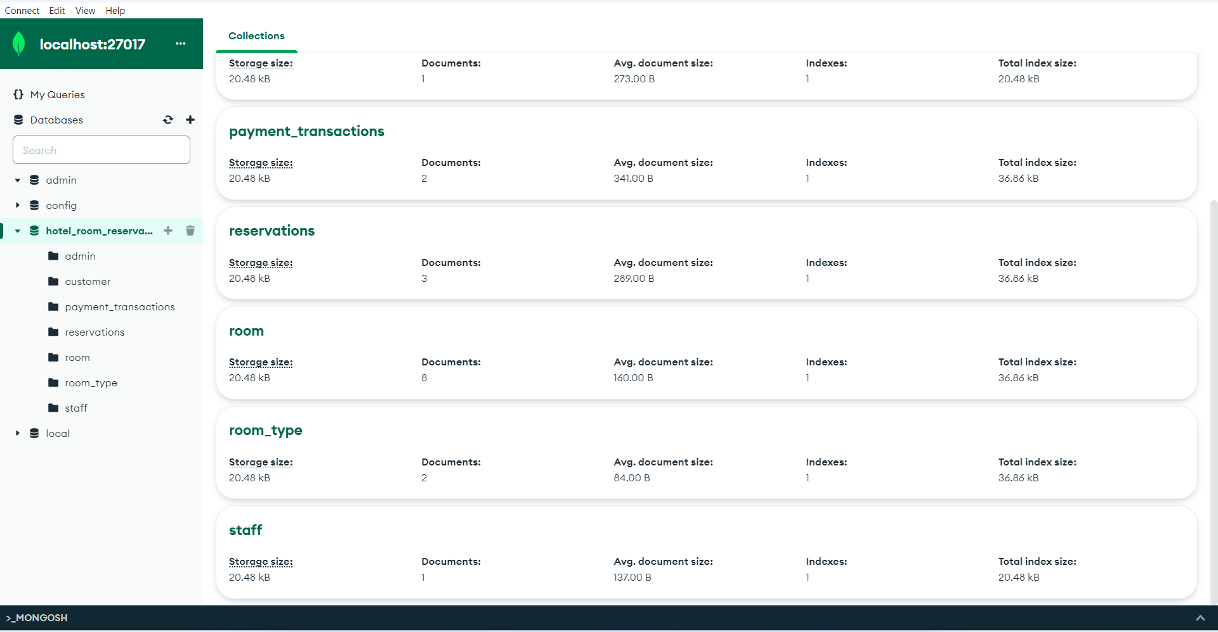

Slide 11
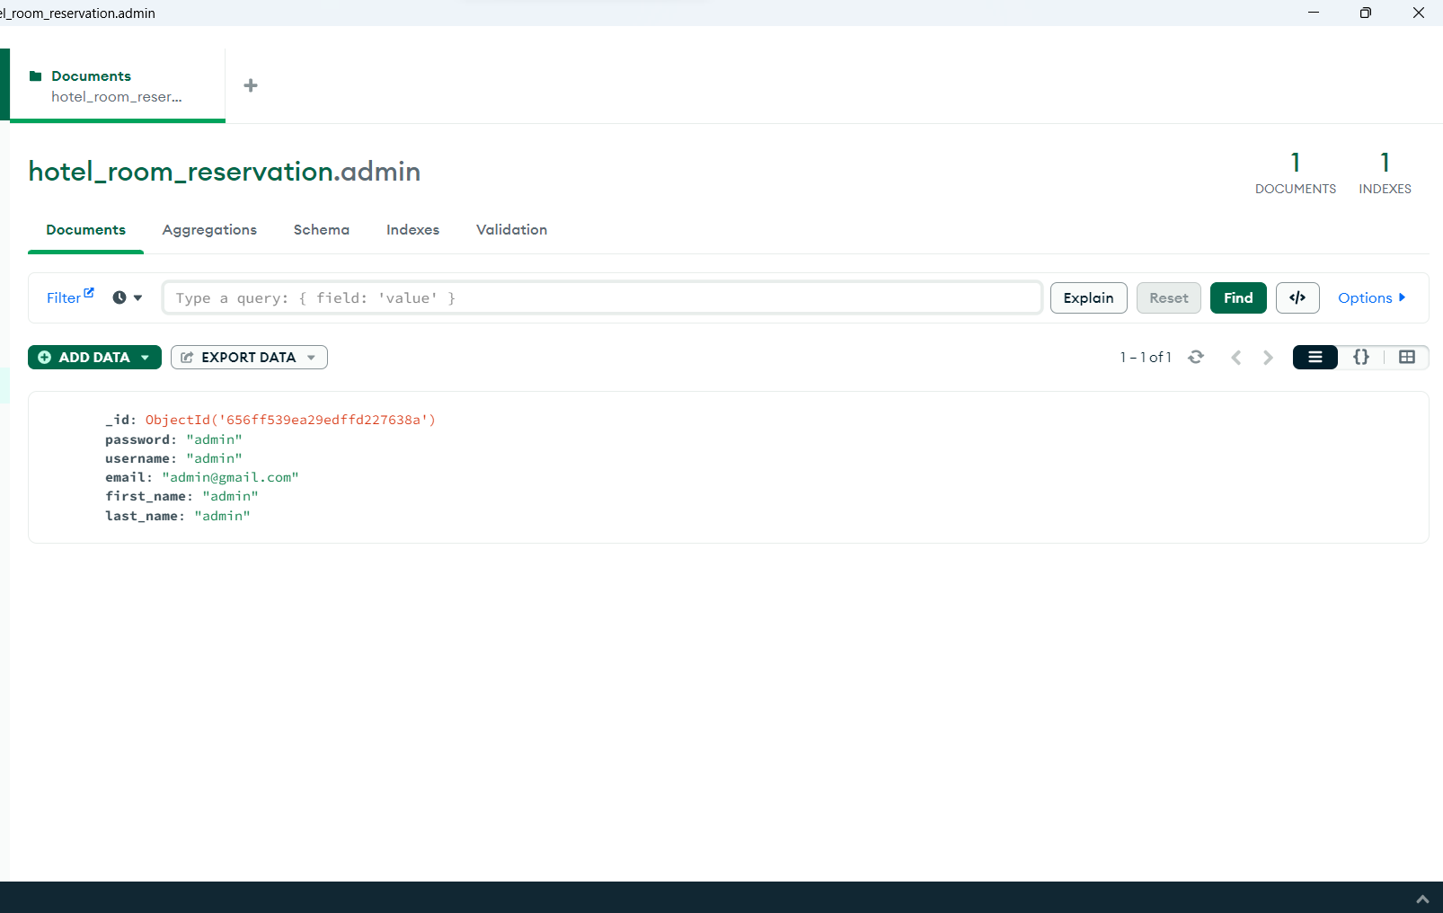

Slide 12
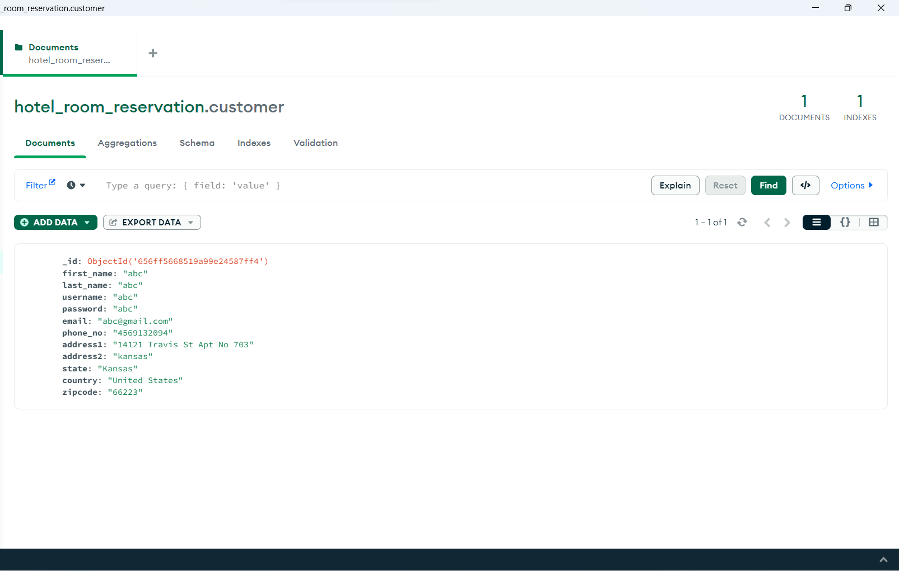

Slide 13
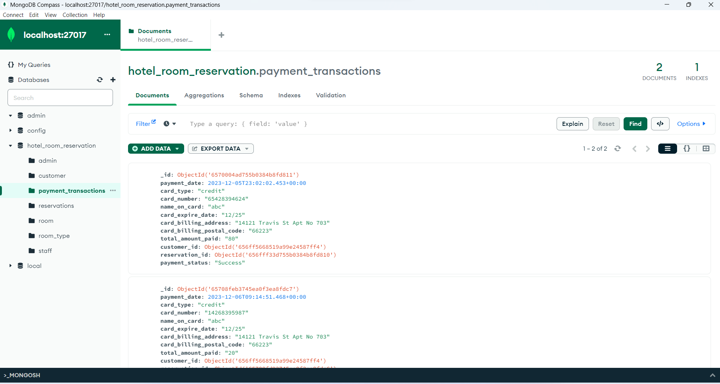

Slide 14
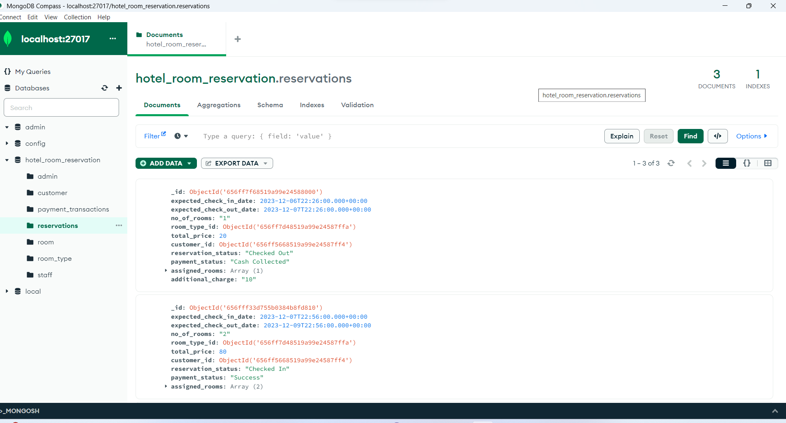

Slide 15
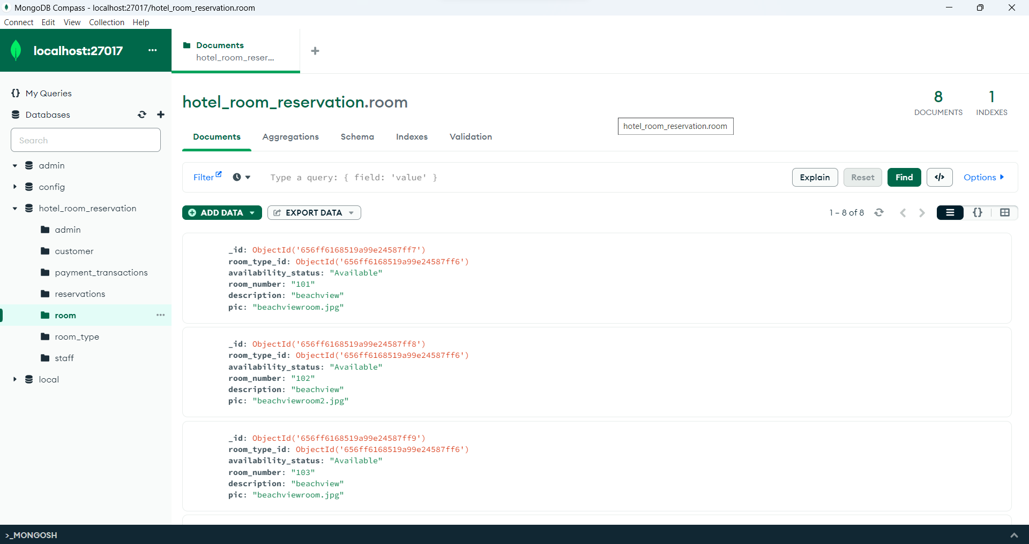

Slide 16
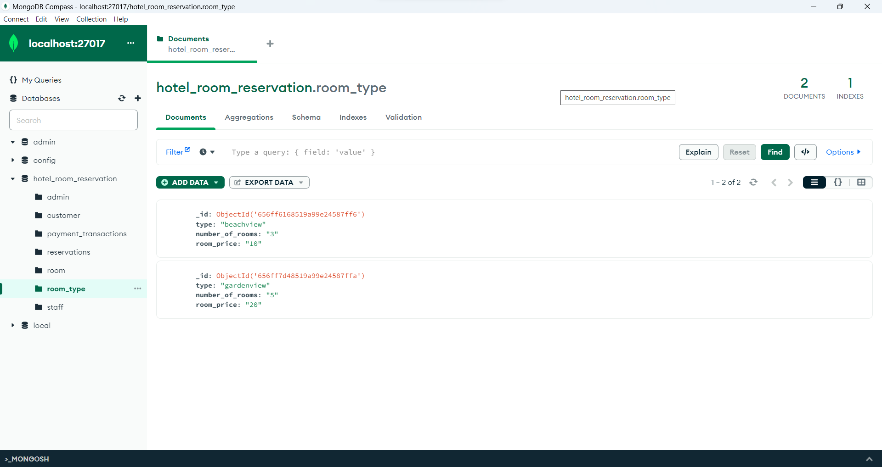

Slide 17
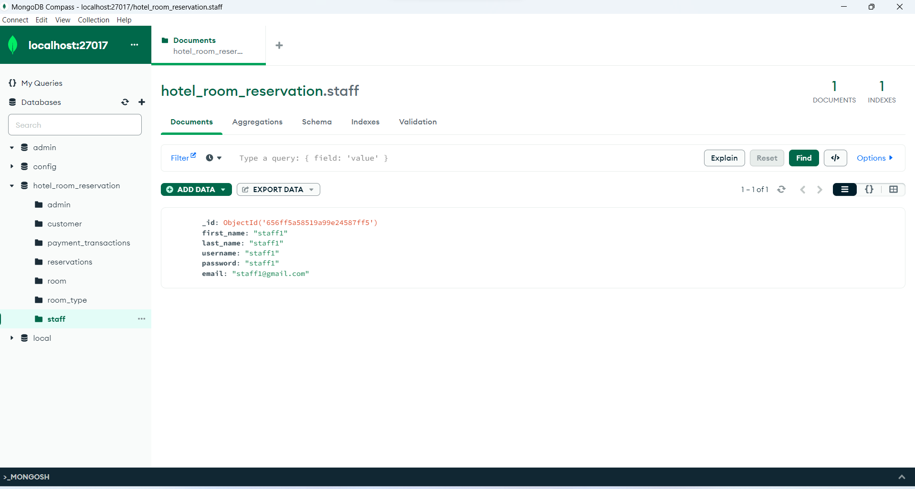

Slide 18

Admin
Add staff members
Add room type
Add rooms
Can check for current, upcoming and booking history

Slide 19

STAFF
Add room type
Add rooms available
Can collect amount from customer
Can check-in and check-out for customer
Can add additional charges (if applicable) at customer checkout

Slide 20

Customer
Registration
Search and book a room
Pay cash online via card
Can view his bookings
Can cancel booking

Slide 21
Features
This application helps us to book a room online beforehand.
This application allows user to pay online during hotel room booking or later during checkout time.
Customers have flexibility to cancel the booking at any time.
Additional charges can be collected by staff during checkout incase of any extra amenities used by customers.

Slide 22
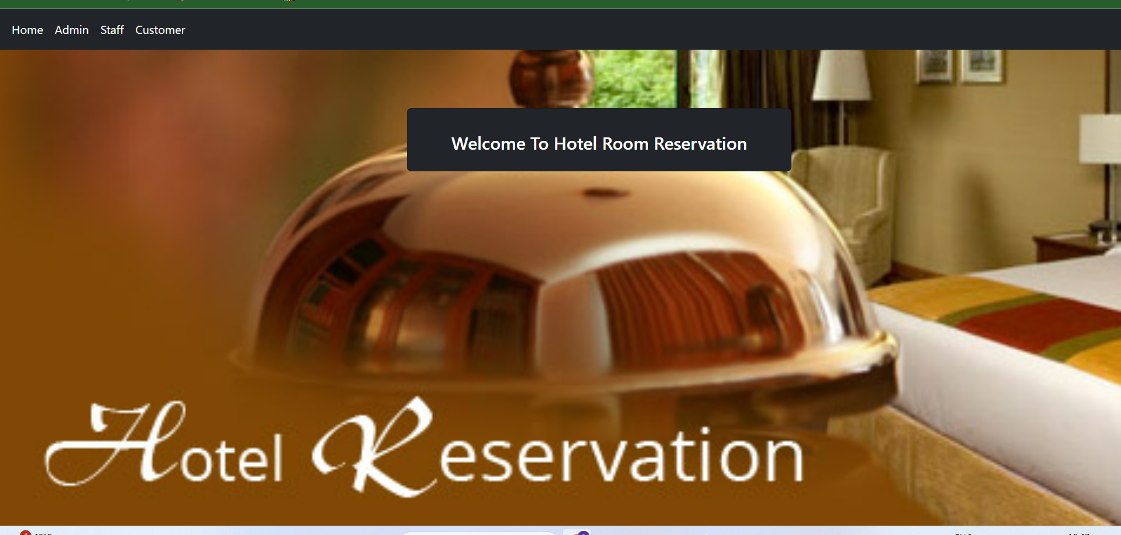
Home Page
This is the Hotel Management System Homepage in which We can see the Admin and Customer links .By Clicking Admin Page is Redirected to the Admin Login Page or by clicking Customer Page is redirected to the user home Page.

Slide 23
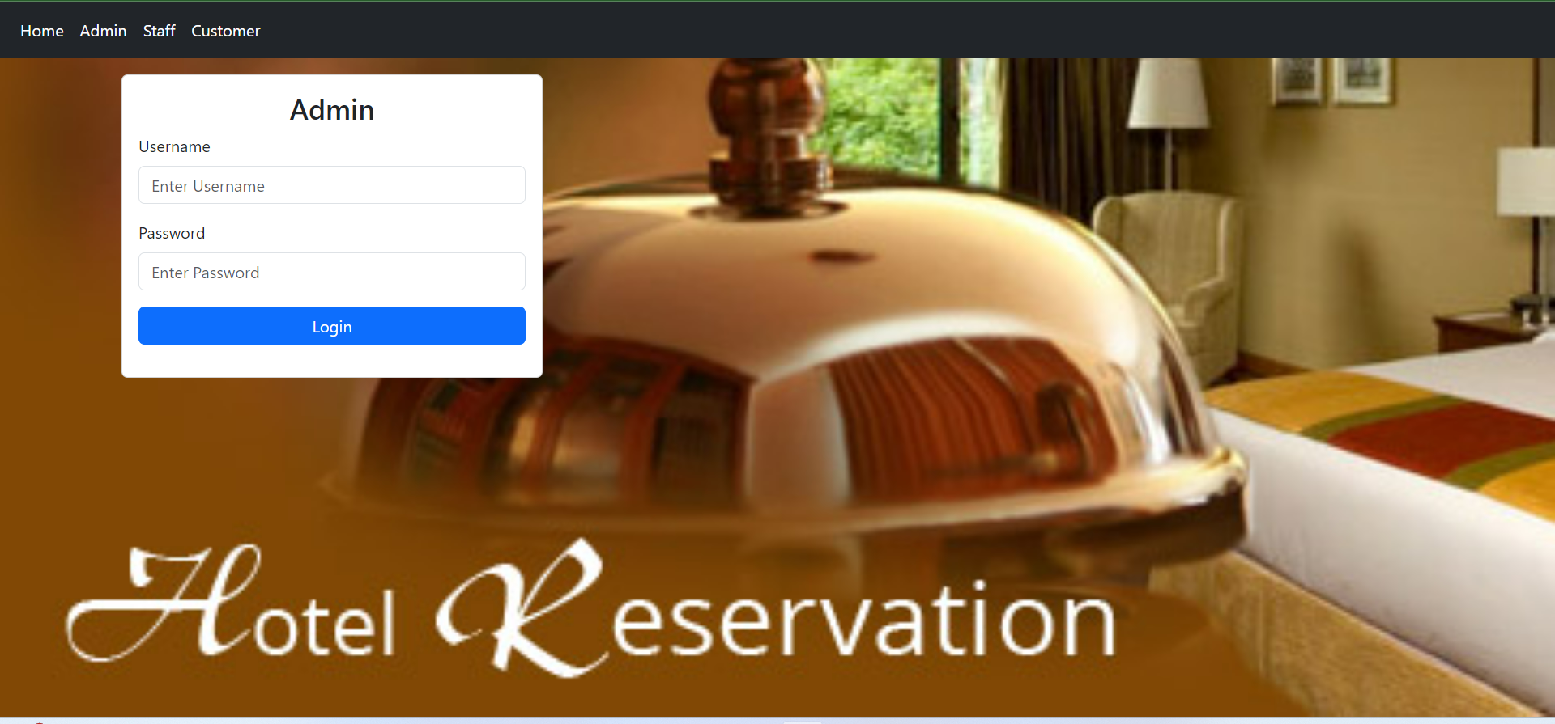
Admin Login Page
This is the Admin Login Page. By entering the Username and Password as admin and clicking on the Login button then the page is redirected to Admin Home Page.

Slide 24
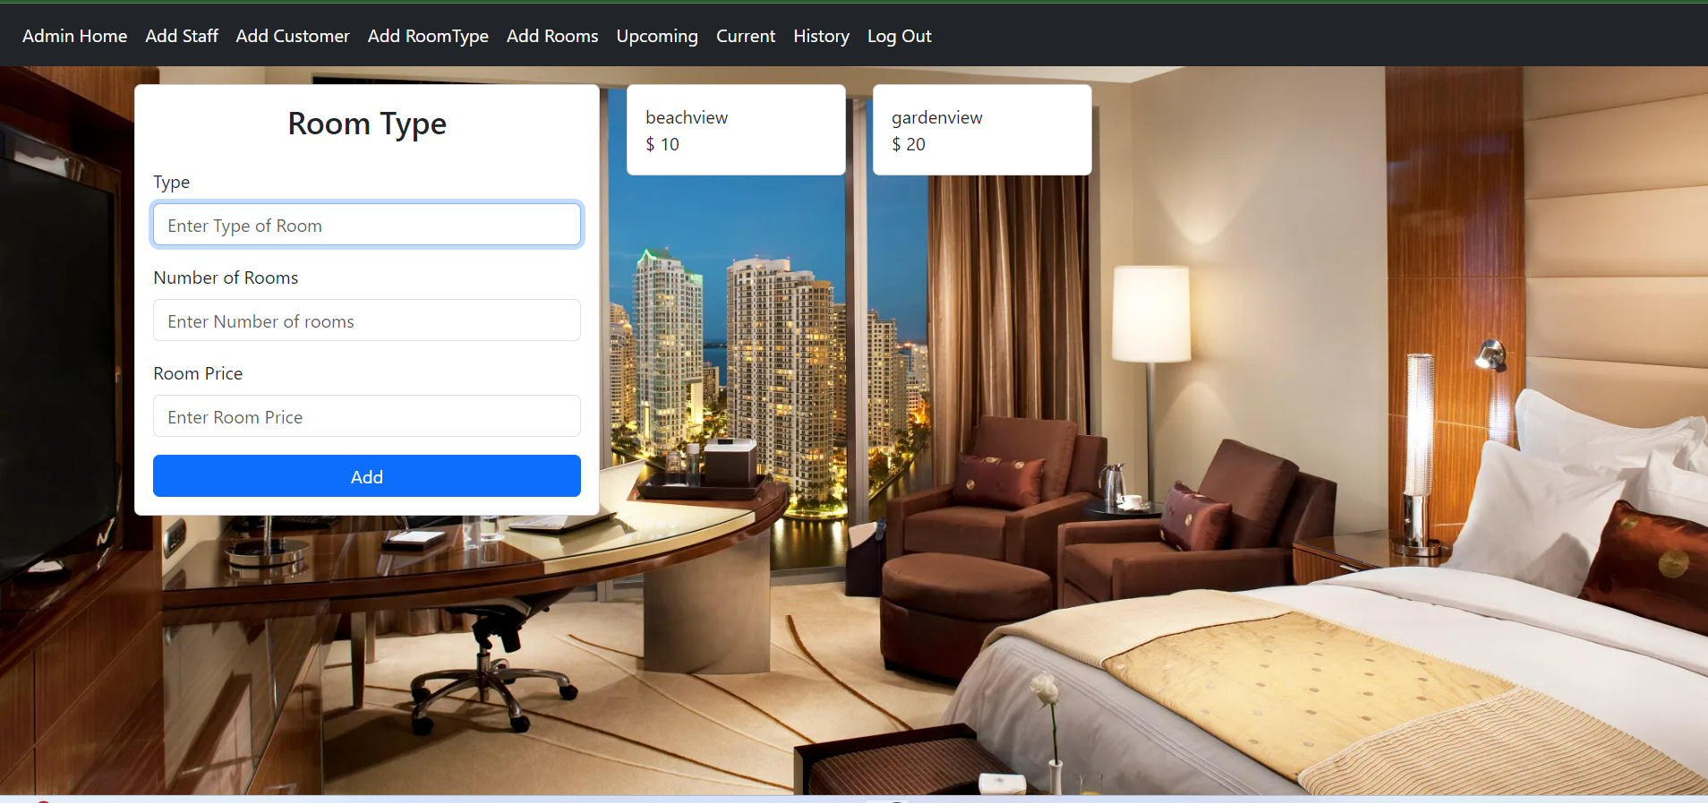
Add Room Type
This is the Add Room Type Page. By clicking on this it will display to select the room type name, number of rooms to be added of that type and room price and then click on Add button then the room is added successfully. Example of beachView and GardenView.

Slide 25
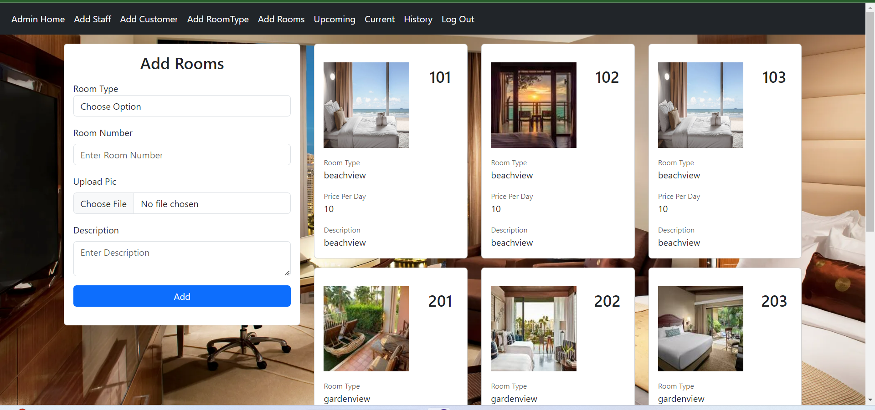
Add Room
This is the Add Room Page.By clicking on this it will display to select the room type like beachView or gardenView, enter room number, choose room image and description and then click on Add button then the room is added successfully.

Slide 26
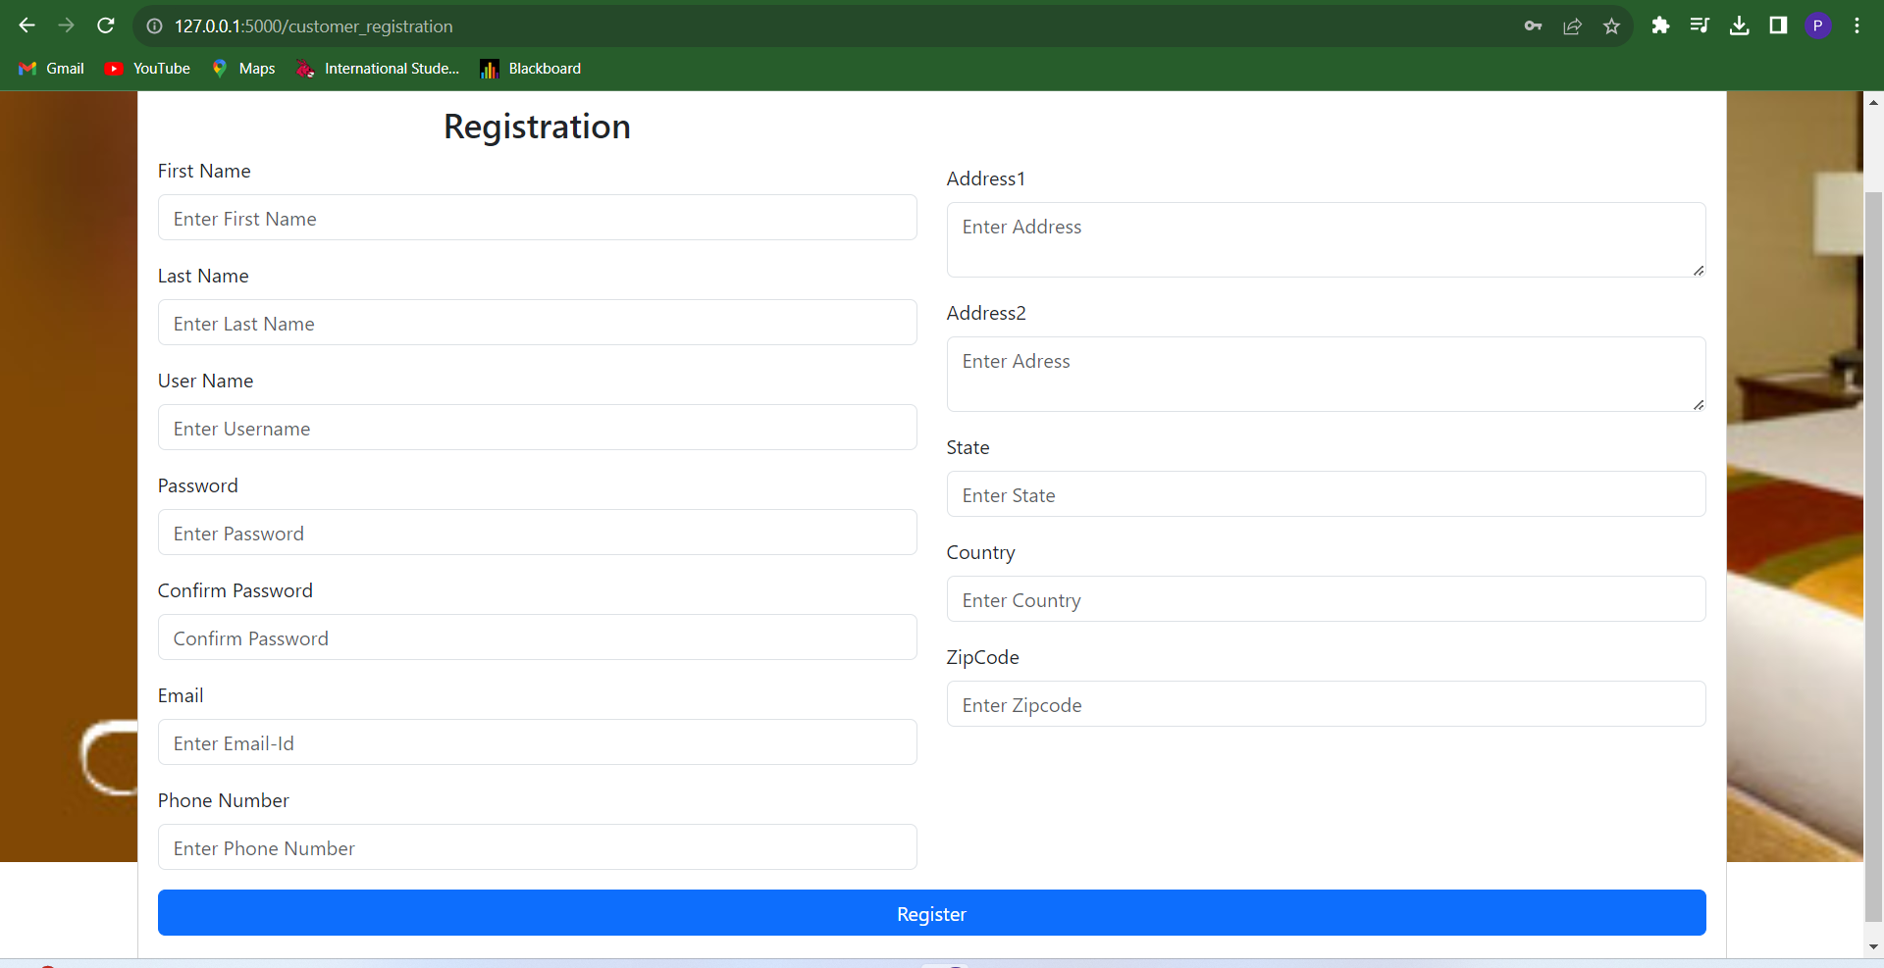
User Registration Page
This is the User Registration Page. In this page we can enter the name, email, phone, address, password, confirm password and the last we can click on the register button then the user registered successfully.

Slide 27
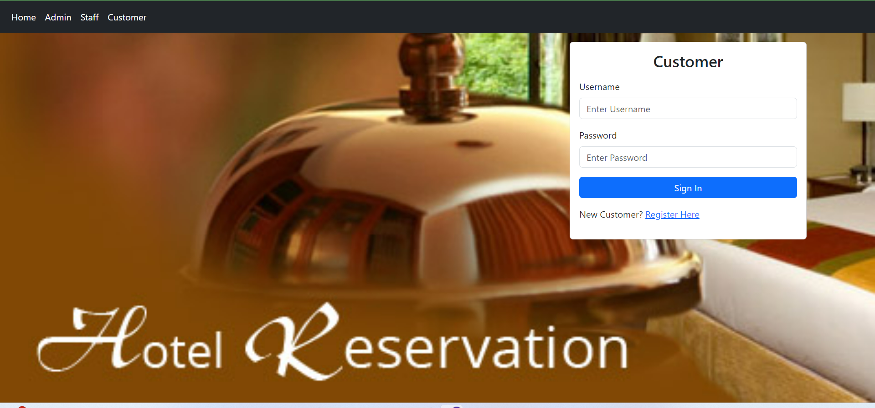
Customer Login Page
This is the Customer Login page. We can enter the Existing and the password and last we can click on the Login button then the page will be redirected to the User Home Page.

Slide 28
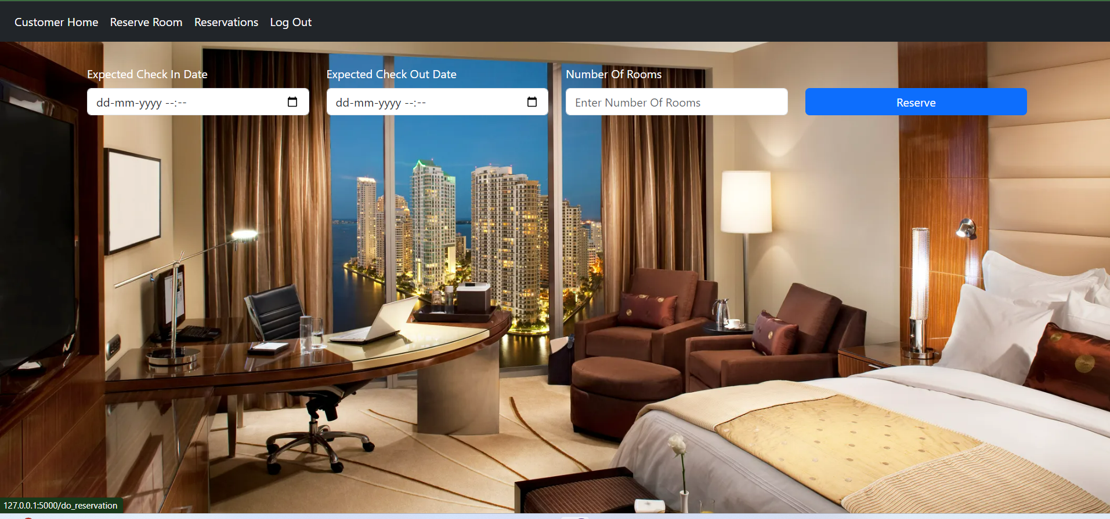
Reserve Room
This is the Reserve Room Page. Here the user chooses the check-in, check-out, number of rooms required and clicks on the reserve button.

Slide 29
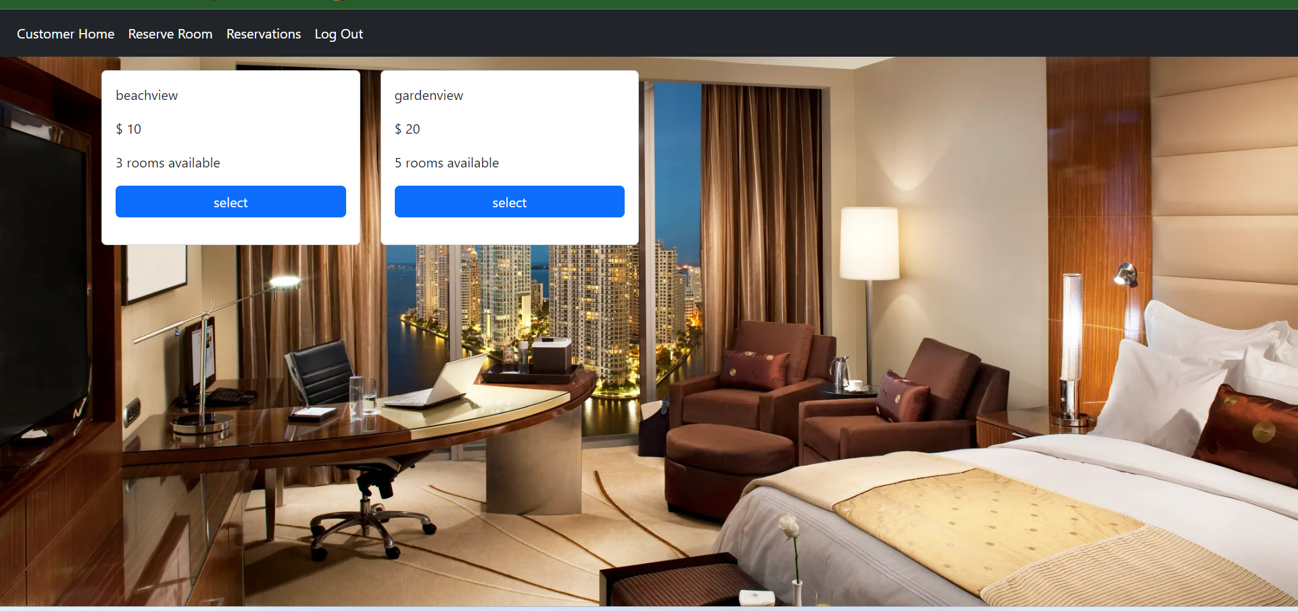
View Rooms
After clicking on the reserve button it shows details about type of room available in hotel and the customer selects room type based on his choice.

Slide 30
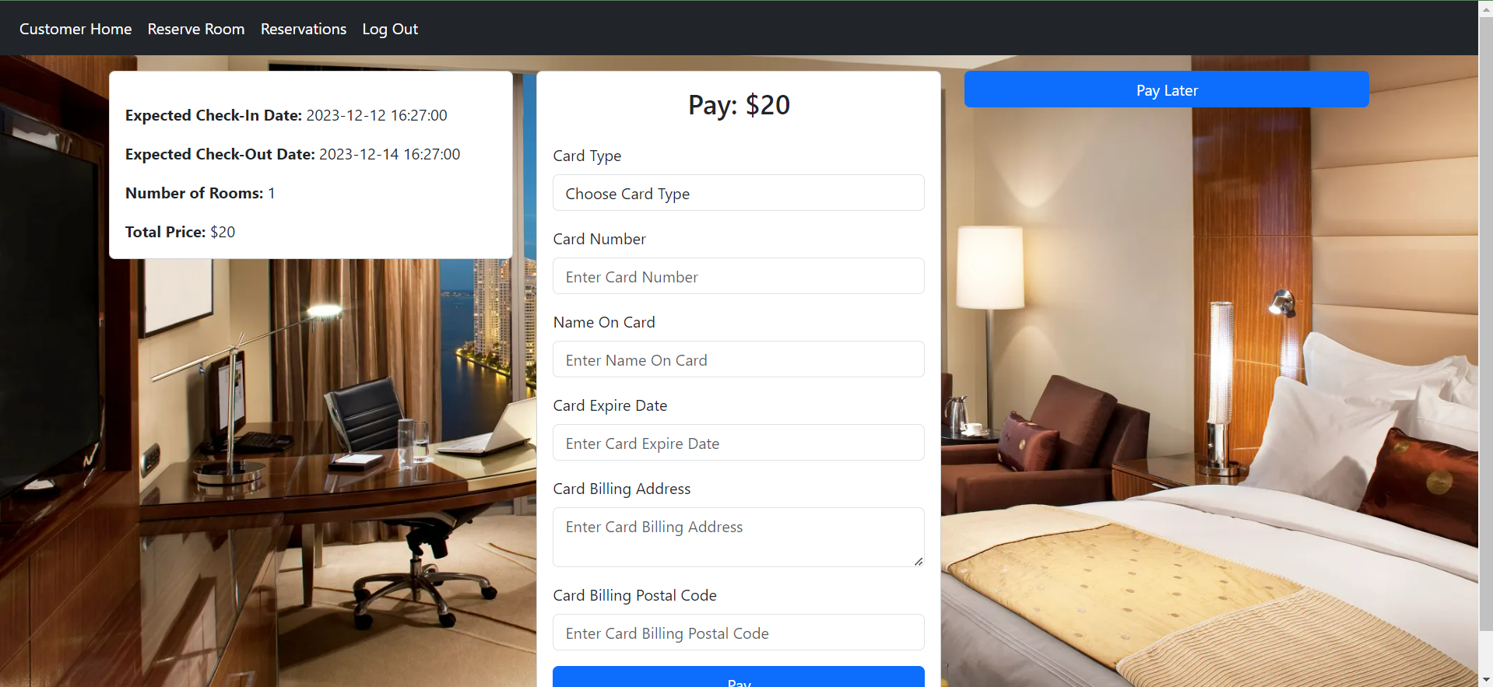
Customer Payment
After clicking on the select button it shows the payment details for the user. Now user will pay the advance amount by giving the card details and click on Pay button to book the room. We also have an option to pay later during check-in.

Slide 31
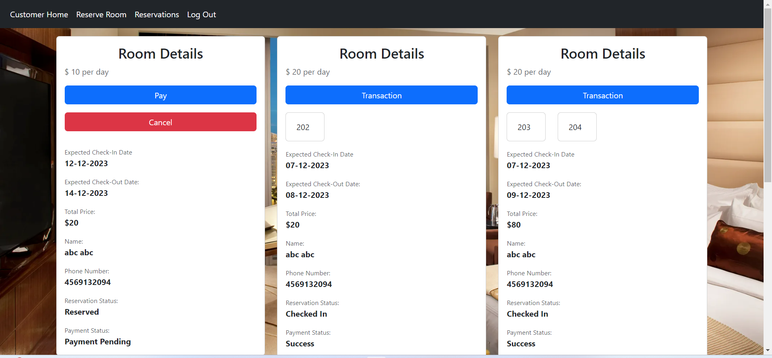
Reservations
This is the Reservations Page. Here the customer can see the room booked details. In this page we can see the see the payment details and also there is a cancel button to cancel the booking.

Slide 32
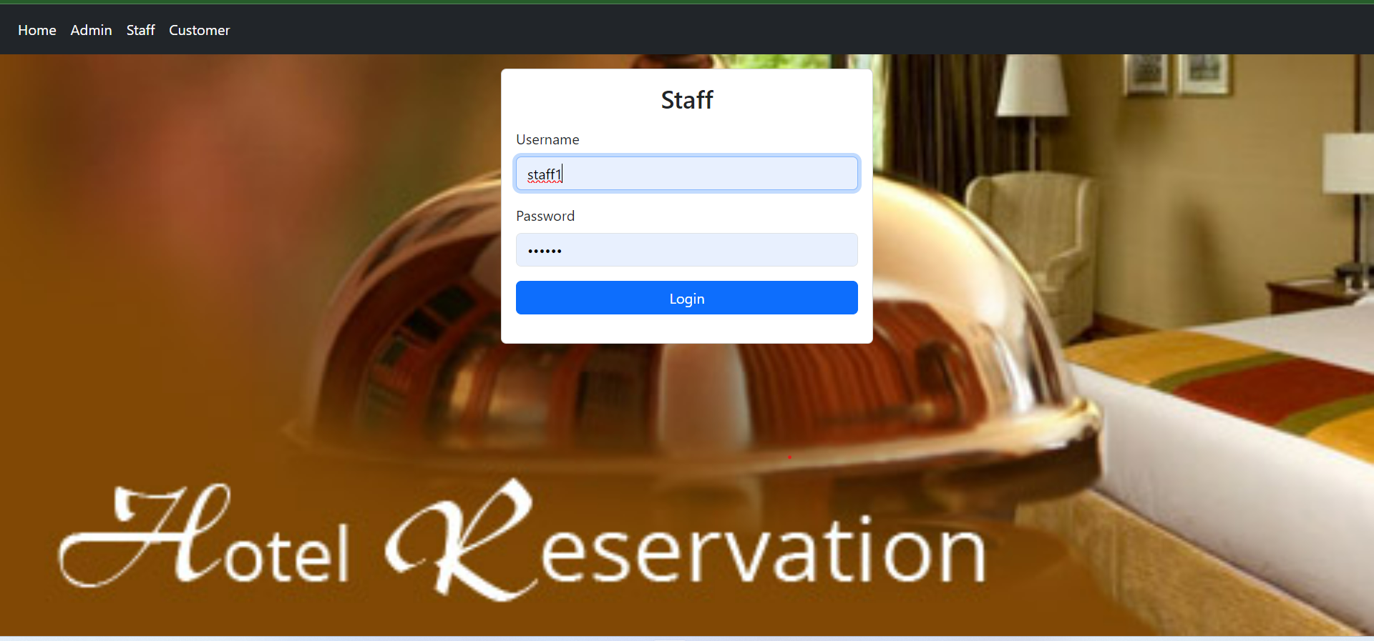
Staff Login Page
This is the staff Login page. Hotel Staff can enter their name and password and can click on the Login button then the page will be redirected to the staff Home Page.

Slide 33
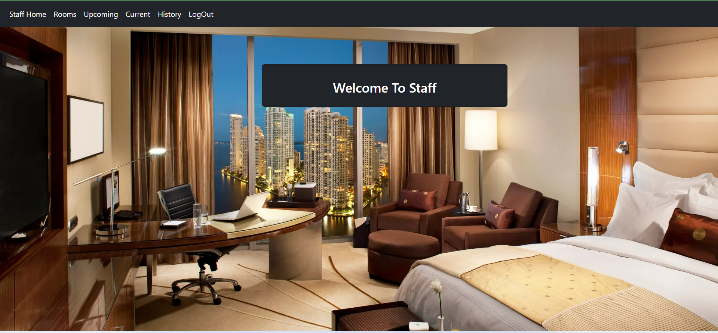
Staff home Page
This is the staff Home page. Staff can add rooms of available type. He has authority to assign rooms for the reserved customers.

Slide 34
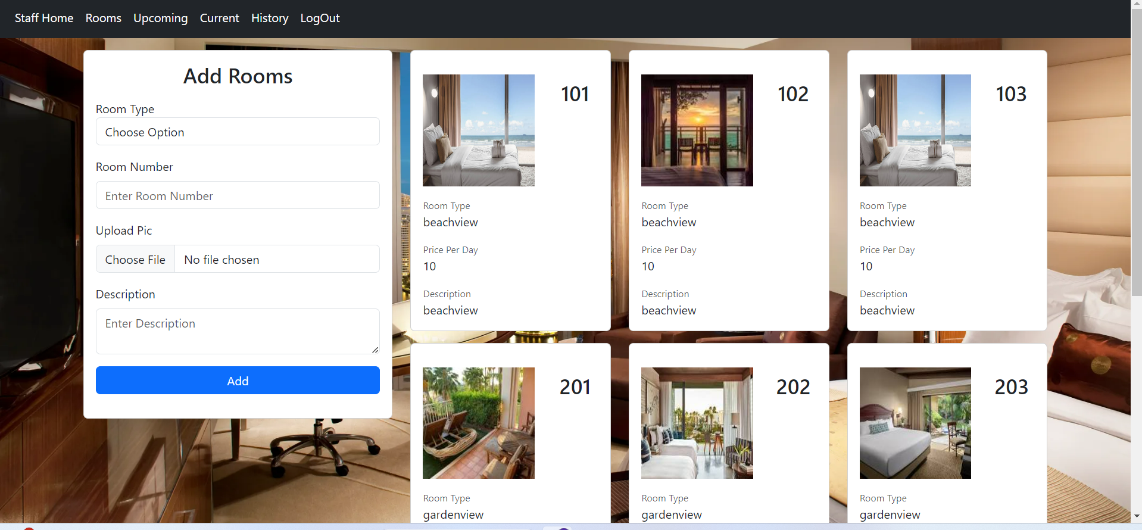
Add Rooms by staff
Staff can add rooms of available type. They can add a room and upload the image and click on add button to create a room.

Slide 35
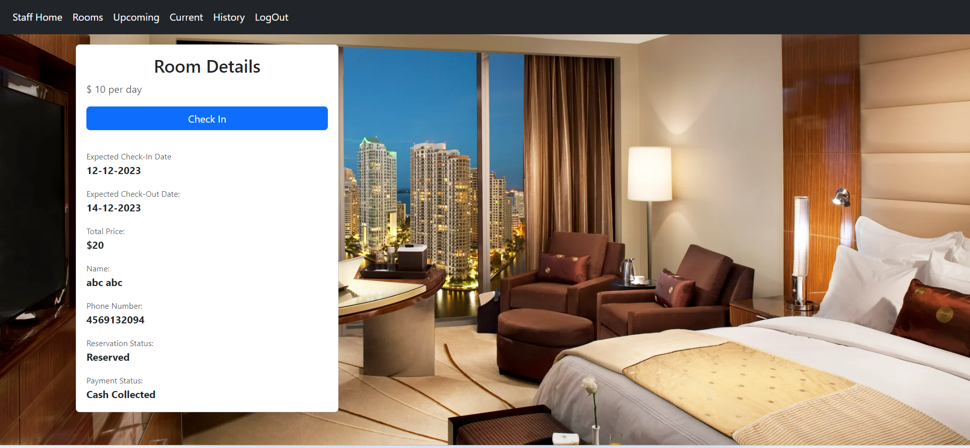
Upcoming Rooms
When staff clicks on upcoming tab, they can see future room booking details of the customers. Once the customer arrives, staff can click on check-in button and select the rooms required.

Slide 36
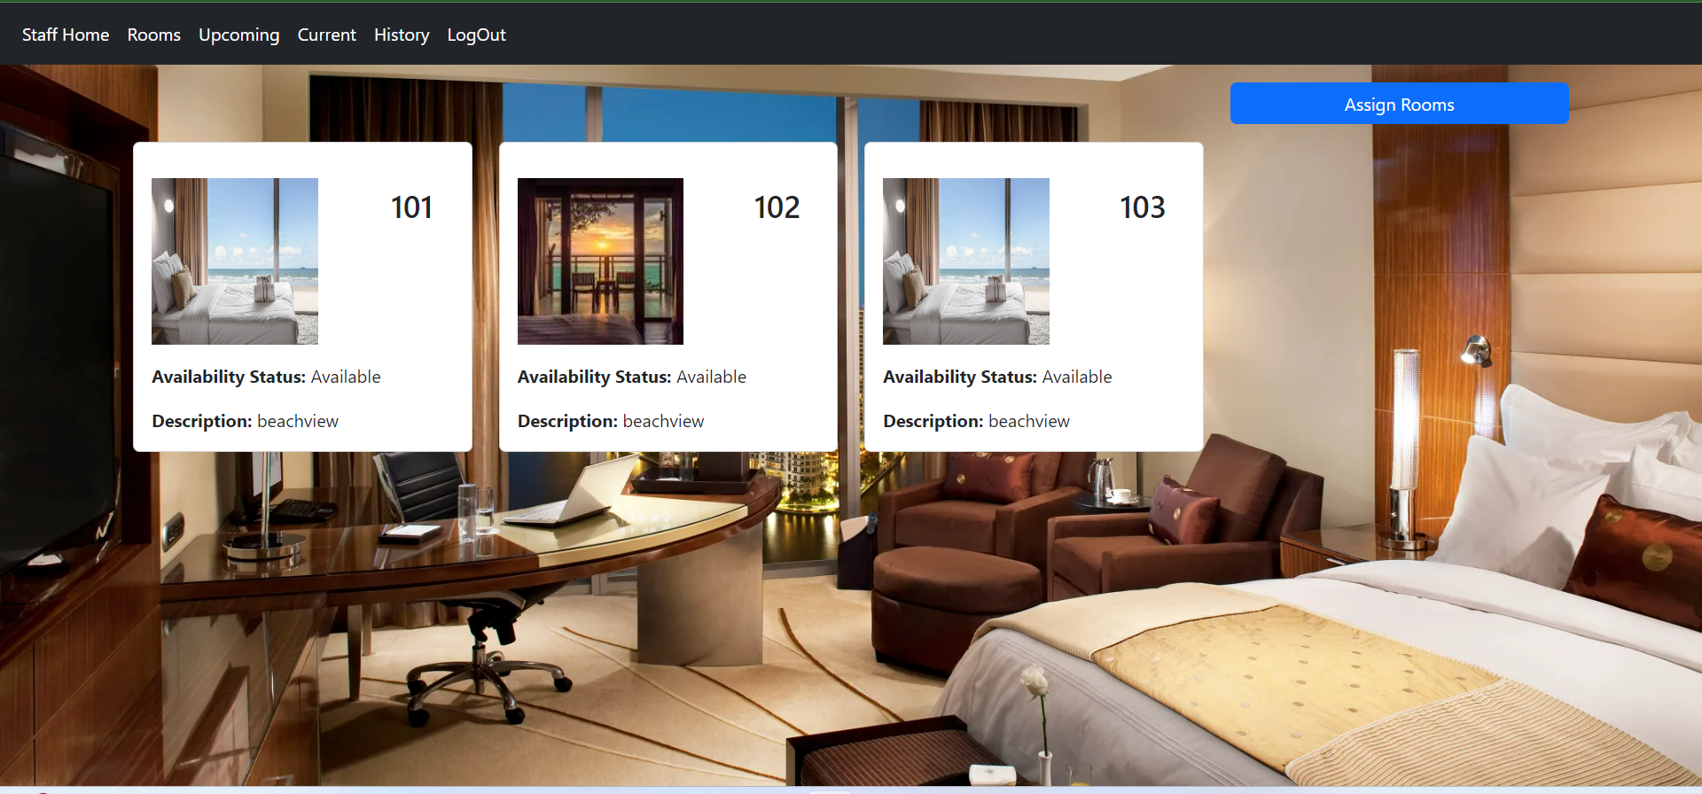
Upcoming Rooms
When staff clicks on check-in button in upcoming tab, he can select the room to be assigned for customer and click on assign rooms button to assign the room.

Slide 37
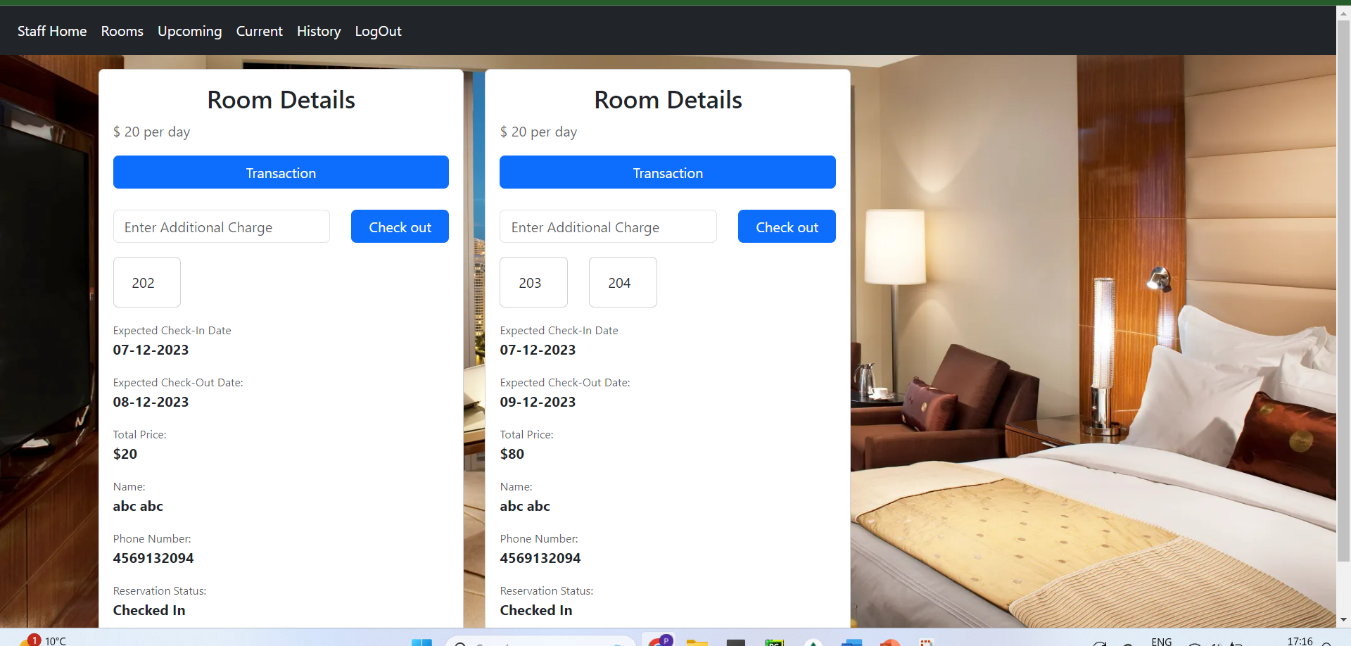
Current Rooms
When staff clicks on current tab, they can see details of the customers in hotel room and also can do check-in and check-out , add additional charges in case of any amenities used by customer.

Slide 38
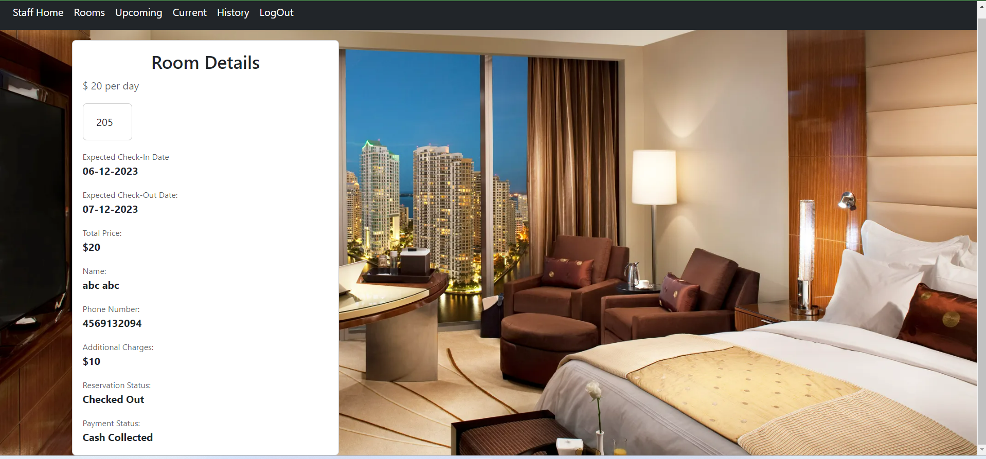
History
This is the History Page. Staff and Admin can see all the history of the cancelled, vacated rooms etc in this page.

Slide 39

Staff will click on check-out button this message is displayed.

Slide 40
Source codes and NoSQL commands are present in HotelMS8 Zip folder

Slide 41

Thank You

